Slide 1

SPEECH BASED EMOTION RECOGNITION USING
MACHINE LEARNING
Main Project By
G. HRITHIK 18481A0583
K. DEVI KIRAN 18481A05A9
K. N. V. NARESH 18481A05B5
Under the guidance of Mrs. G. Bharathi, M. Tech, (Ph. D)
Sr. Gr. Assistant Professor, Department of CSE
DEPARTMENT OF COMPUTER SCIENCE AND ENGINEERING
SESHADRI RAO GUDLAVALLERU ENGINEERING COLLEGE
(An Autonomous Institute Permanently affiliated to JNTUK)
Seshadri Rao Knowledge Village
GUDLAVALLERU – 521356
ANDHRA PRADESH
2020-2021

Slide 2
Abstract
Speech Emotion Recognition (SER) plays an indispensable role in intelligent speech application. SER, is the act of attempting to recognize human emotion and affective states from speech. There are several modalities for expressing human emotions like body-posture, facial expression & voice. The human voice can be characterized by several attributes such as pitch, timbre, loudness, and vocal tone. It has often been observed that humans express their emotions by varying different vocal attributes during speech generation. T
The proposed approach is based upon python modules like PyAudio, Librosa for audio input and analysing it and the MLP Classifier for Feature Extraction and Classification. For evaluated models of different experiment settings reports accuracy, f-score, precision and recall. However, the performance of previous work has been restricted by neglecting the interaction of different frequencies, since the converged communication of frequency is also critical for us to generate accurate emotion feature representations. The proposed method includes the previously neglected frequencies which can lead to accurate prediction of emotions.

Slide 3
Existing System
There are three classes of features in a Emotion Recognition, the lexical features (the vocabulary used), the visual features (the expressions the speaker makes) and the acoustic features (sound properties like pitch, tone, jitter, etc.).
The existing work relies more on lexical analysis for emotion recognition, that have been used for the purpose of classification of emotions into three categories, i.e., Angry, Happy and Neutral.
Discrete Classification
Classifying emotions in discrete labels like anger, happiness, boredom, etc.
Dimensional Representation
Representing emotions with dimensions such as Valence (on a negative to positive scale), Activation or Energy (on a low to high scale) and Dominance (on an active to passive scale)

Slide 4
Problem Statement
An SER system needs a classifier, a supervised learning construct, programmed to perceive any emotions in new speech signals.
A supervised system like that introduces the need for labeled data with emotions embedded in it. Before any processing can be done on the data to extract the features, it needs preprocessing.
For this reason, the sampling rate across all the databases should be consistent. The classification process essentially requires features.
They help reduce raw data into the most critical characteristics only, regardless of whether it suffices to utilize acoustic features for displaying emotions.
Various algorithms have been deployed over the years for the two important processes involved in SER (Speech Emotion Recognition) namely feature extraction and the decision making. To date, numerous acoustic features and classifiers have been put through experimentation to test their credibility, but the accuracy still needs to be improved.

Slide 5
Proposed System
To build a model to recognize emotion from speech using the librosa and Multi Layer Perception Classifier (MLP Classifier) and RAVDESS Dataset.
This will be able to recognize emotion from sound files. We will load the data, extract features from it, then split the dataset into training and testing sets.
Then, we’ll initialize an MLP Classifier and train the model. Finally, we’ll calculate the accuracy of our model.
Recognizing the emotion from the user given audio file and displaying the output emotion on the screen.

Slide 6
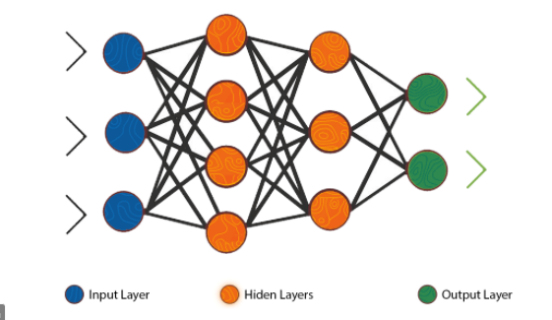
MLP Classifier
The Multi Layer Perceptron(MLP) is a feedforward artificial neural network model that maps input data sets to a set of appropriate outputs.
An MLP consists of multiple layers and each layer is fully connected to the following one. The nodes of the layers are neurons with nonlinear activation functions, except for the nodes of the input layer.
Between the input and the output layer there may be one or more nonlinear hidden layers.
Multilayer perceptrons are often train on a set of input-output pairs and learn to model the correlation (or dependencies) between those inputs and outputs.

Slide 7
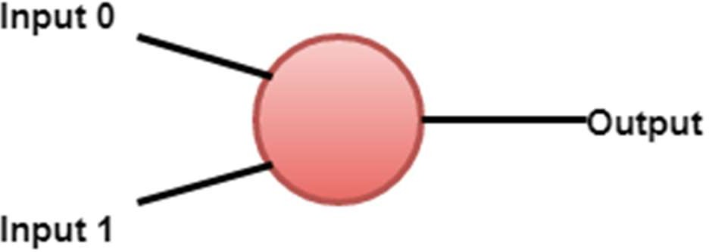
Perceptrons
A multilayer feedforward neural network is a linkage of perceptrons in which information and calculations flow are unidirectional, from the input data to the outputs. The total number of layers in a neural network is the same as the total number of layers of perceptrons.
The easiest neural network is one with a single input layer and an output layer of perceptrons. The concept of feedforward artificial neural network having more than one weighted layer. As the system has at least one layer between the input and the output layer, it is called the hidden layer.
Perceptron is a single layer neural network. It is a binary classifier and part of supervised learning. A simple model of the biological neuron in an artificial neural network is known as the perceptron. The artificial neuron has input and output.

Slide 8
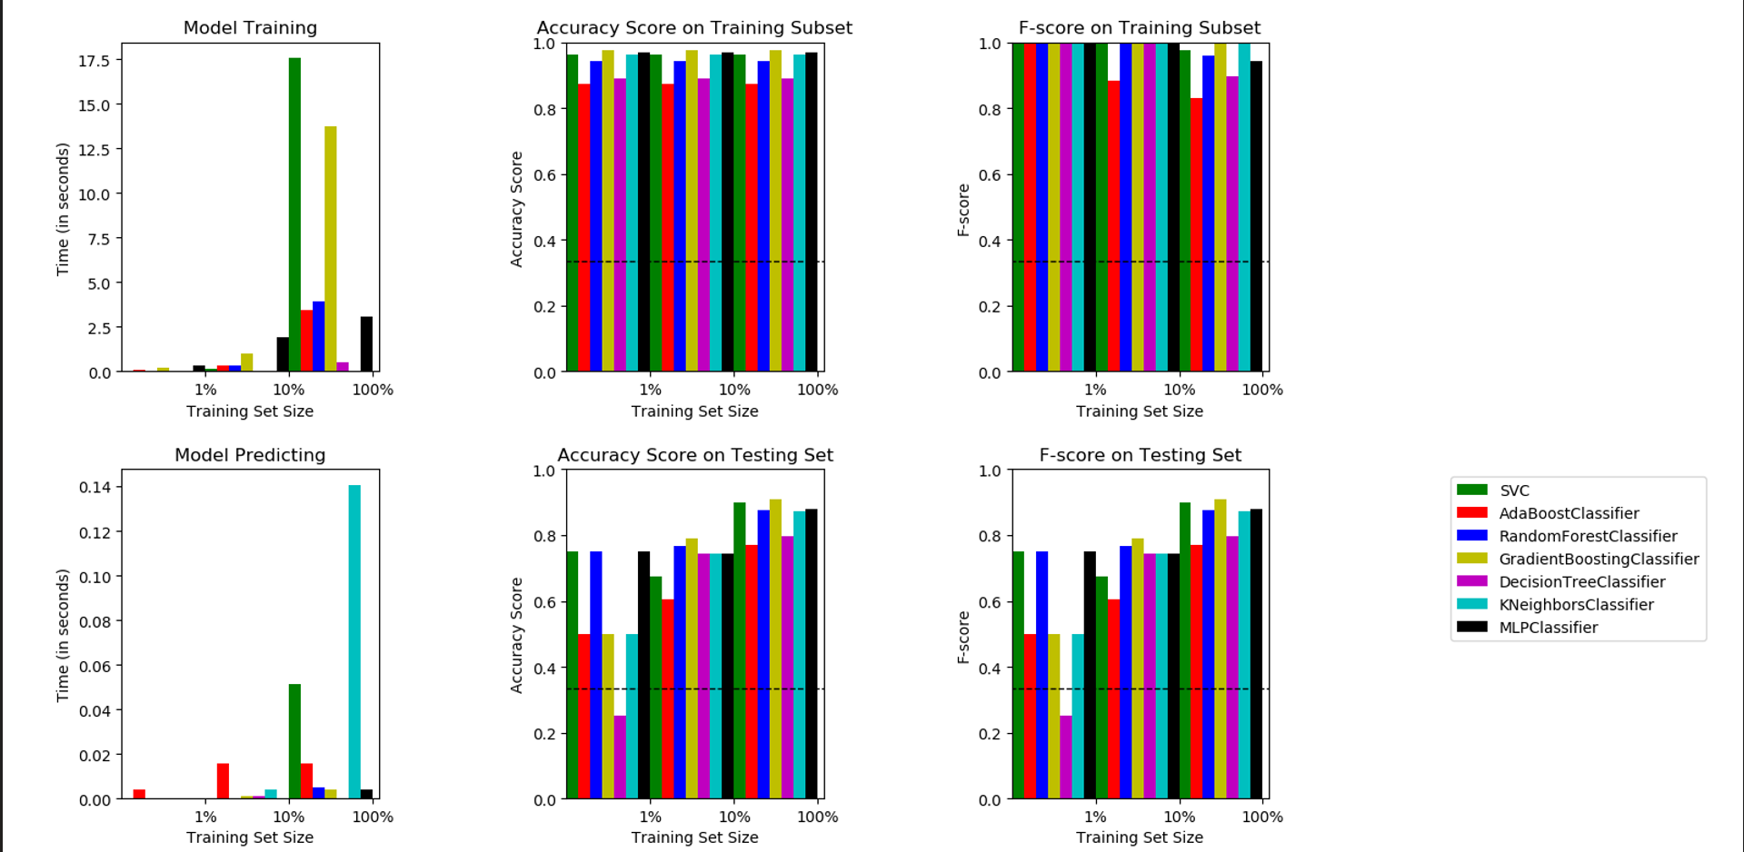
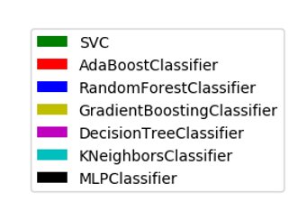

Slide 9
Implementation
Importing Modules
DataSet Collection
Feature Extraction
Testing and Training
Building the model
User Audio Input
Process the Audio
Predict the Emotion
Display the Emotion

Slide 10
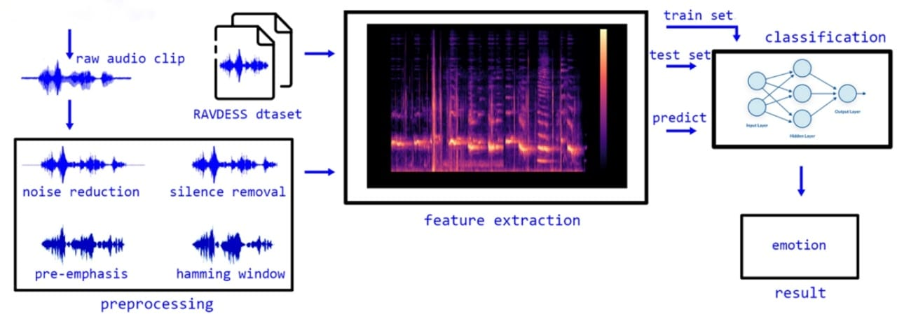
Architecture

Slide 11
RAVDESS Dataset
The Ryerson Audio-Visual Database of Emotional Speech and Song (RAVDESS) contains 7356 files (total size: 24.8 GB). The database contains 24 professional actors (12 female, 12 male), vocalizing two lexically-matched statements.
Speech includes calm, happy, sad, angry, fearful, surprise, and disgust expressions, and song contains calm, happy, sad, angry, and fearful emotions.
Speech folder contains 1440 files: 60 trials per actor x 24 actors = 1440. Each of the 7356 RAVDESS files has a unique filename (ex : 02-01-06-01-02-01-12.mp4).

Slide 12
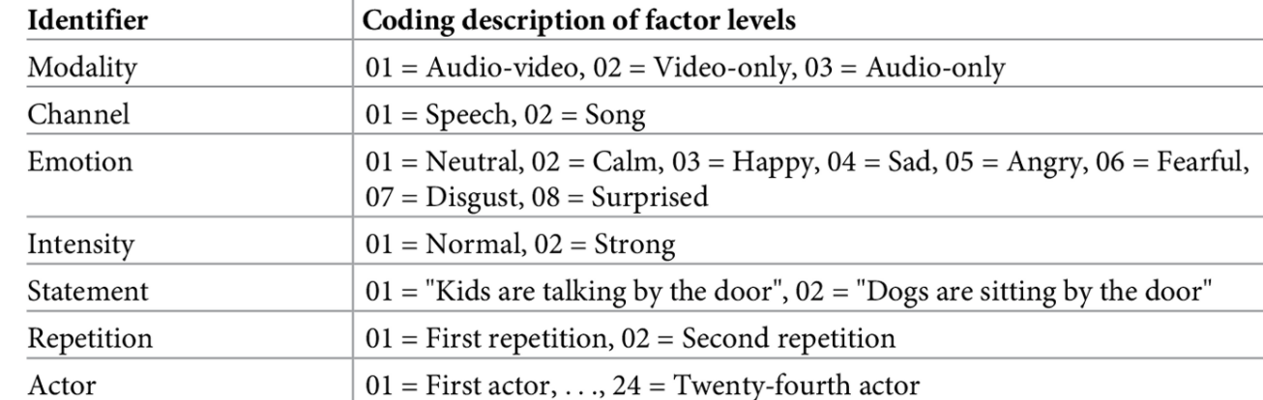
Filename example: 03-01-06-01-02-01-12.wav
Audio-only (03)
Speech (01)
Fearful (06)
Normal intensity (01)
Statement "dogs" (02)
1st Repetition (01)
12th Actor (12) - Female, as the actor ID number is even.

Slide 13
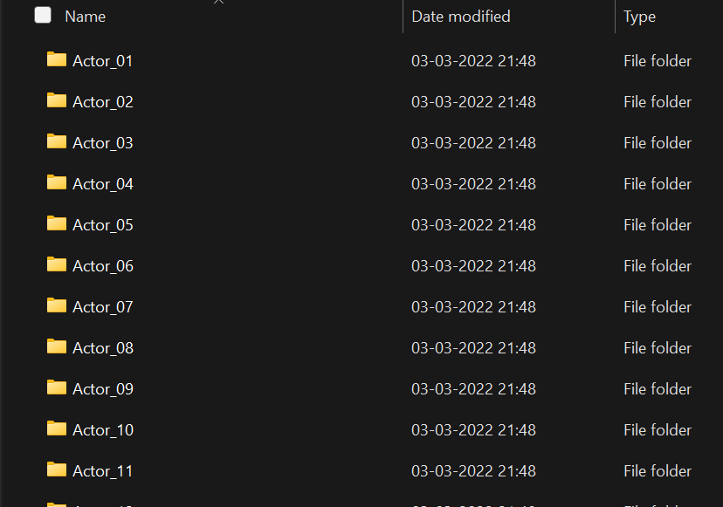
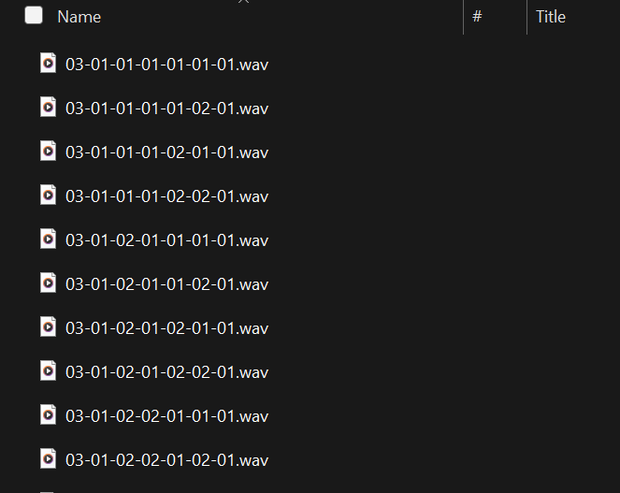

Slide 14
Audio Features
Prosodic Features
Spectral Features
Mel Frequency Cepstral Coefficients
Linear Prediction Cepstral Coefficients
Gammatone Frequency Cepstral Coefficients
Voice Quality Features
Teager Energy Operator Based Features

Slide 15
Feature Extraction
Mfcc : Mel Frequency Cepstral Coefficient, represents the short-term power spectrum of a sound. It basically includes windowing the signal, taking the log of the magnitude and then wrapping the features on a mel scale, followed by the inverse DCT.
Chroma : Pertains to the 12 different pitch classes. High-level features intend to build user related concepts out of low and mid level features.
Mel : Mel Spectrogram Frequency. It is a scale of pitches judged by listeners to be equal in distance one from another.

Slide 16
Librosa and PyAudio
Librosa is a python package for music and audio analysis. It provides the building blocks necessary to create music information retrieval systems.
Librosa is basically used to work with audio data like in Music Generation, Automatic Speech Recognition.
It provides the building blocks necessary to create the music information retrieval systems. Librosa helps to visualize the audio signals.
PyAudio provides python bindings for PortAudio, the cross-platform audio I/O library. With PyAudio, you can easily use Python to play and record audio on a variety of platforms.
pip install librosa
pip install PyAudio

Slide 17
Training Process
No Speech detected
Silence
Extract Features for each emotion Audio Sample
Fetch 80% of RAVDESS Dataset for training
the model
Check for Audio
Augument the Audio Samples
Audio
Predict the emotion
Save the Model

Slide 18
Testing Process
Neutral Emotion Detection
Parameters not detected
Fetch 20% of RAVDESS Dataset for testing the model
Check for Parameters
Parameters detected
Send the Audio to Saved Model to predict the data
Accuracy of the Testing Data

Slide 19
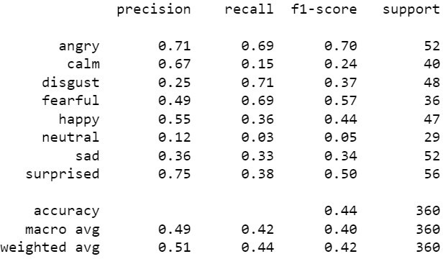
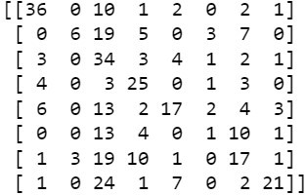
Classification Report & Confusion Matrix :
Classification report is often defined as the performance metric for the machine learning model. It is used to determine the precision, recall, f1-score and support of the machine learning model. The following depicts the precision, recall, f1-score and support of the emotions (angry, calm, disgust, fearful, happy, neutral, sad, surprised) of the built machine learning model.
The following is the confusion matrix of the model of the given 8 (i.e 8*8 matrix) emotions.

Slide 20
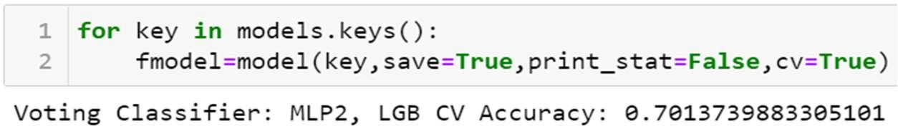
Accuracy
The accuracy of the model using MLP (Multi Layer Perceptron) Classifier along with the LGB (Light Gradient Boost) combined by using the Voting Classifier resulted in higher accuracy compared to the previous systems.

Slide 21
Modules
Librosa
Pyaudio
TensorFlow
Numpy
Pandas
Soundfile
Wave
Sklearn
Matplotlib
Os, Glob, Pickle

Slide 22
Requirements
SOFTWARE REQUIREMENTS
IDLE : Google Collab
Operating System: Windows 7 or Above
Programming Language: Python 3.8
HARDWARE REQUIREMENTS
RAM: 4GB
2 GB of Drive Storage for storing the RAVDESS Dataset and project files.
Processor : Intel Core i or Ryzen

Slide 23
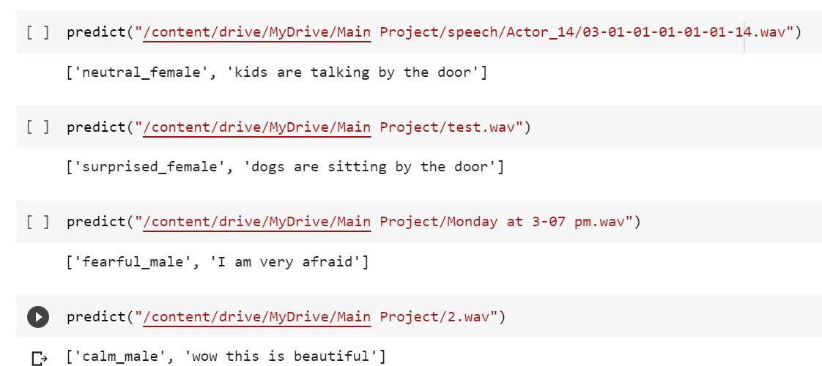
Output

Slide 24
Published Paper
Proposed Sytem has been executed successfully and paper has been published under The International Journal of Analytical and Experimental Model Analysis
DOI : 18.0002.IJAEMA.2022.V14I04.200001.01568596949
https://drive.google.com/file/d/1y87xCwkTpQp7W0hYFPWENPJNopgMsVGp/view

Slide 25
Thank you......

